Slide 1
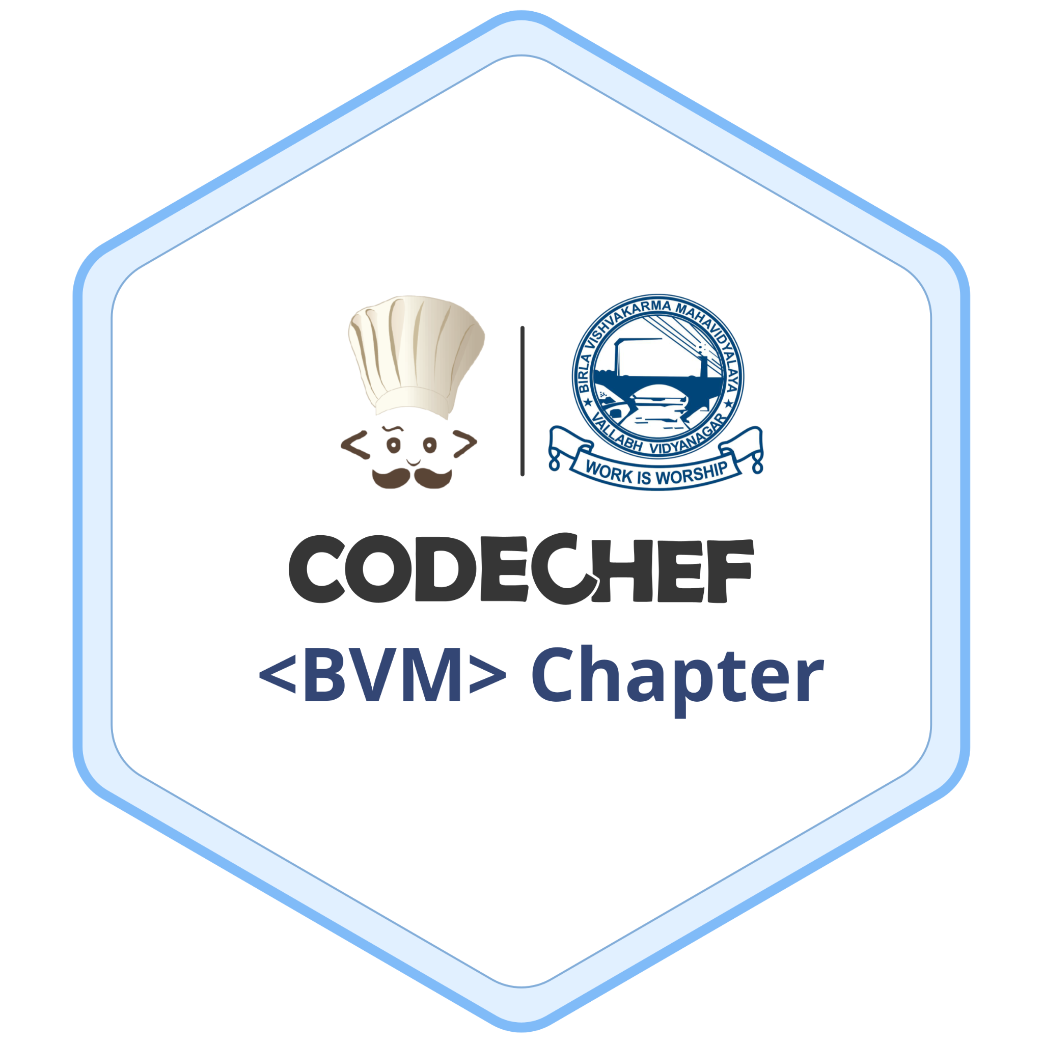
CodeChef BVM Chapter
Cook your code with us

Slide 2
What is CodeChef BVM Chapter?
Providing students a way to connect to Competitive Coding.
Providing many students to work on their problem solving skills.
Helping Students to write code more efficiently.
Helping Students to increase their logical thinking.

Slide 3
TABLE OF CONTENTS
01
03
04
02
05
Competitive Coding
Prerequisites
Busting Myths
06
Benefits of competitive coding
Programming Languages
Demo

Slide 4
01
COMPETITIVE CODING

Slide 5

Competitive Coding
What is Competitive Coding?
How to start?
Scopes

Slide 6







Where to start?

Slide 7
02
BENEFITS OF COMPETITIVE CODING

Slide 8
Benefits
Improves Focus
Career preparation
Fast approach to problems
It is a mind sport that improves focus and attention span.
Helps you to crack
interviews.
Helps you to efficiently work under pressure

Slide 9
03
PREREQUISITES

Slide 10
Prerequisites to start competitive coding
A programming language
Data Structures
Library of selected language
Select one of the several languages and familiarize it.
Basic knowledge of dsa is always helpful yet not necessary.
Useful to get more functionality with lesser code.

Slide 11
04
PROGRAMING LANGUAGES USED IN COMPETITIVE CODING

Slide 12
 | Execution Time(op/sec) | Advantages over other languages
C/C++ | 10⁹~ | Efficient fast and powerful.
Java | 5 * 10⁷~ | Abundance of inbuilt libraries.
Python | 10⁶~ | Easy to learn, clear syntax.

Slide 13
75%
Competitive coders prefer C++ over
other programming languages.

Slide 14
05
Busting Myths of Competitive Coding

Slide 15
Myths related to competitive coding.
Competitive programming is compulsory for cracking tech-giants.
Competitive programming must be the top priority and Development skills are of no use.
Competitive programming can only be done in “X” language.

Slide 16
06
Demo of Competitive Coding

Slide 17

Ask away your questions

Slide 18


Thank you
Hope you enjoyed the session
Ways to connect with us:
Feedback form:

